Slide 1
2024 Redistricting Study
Public Information Session 2
October 21, 2024
Presented by: Dublin City Schools and Cropper GIS Consulting

Slide 2
Welcome and Introductions

Slide 3
Tonight’s Purpose
  Learn how the community-based redistricting study process has been working.
  Review DRAFT boundary options for the Elementary and Middle Schools in the study area and speak directly with Internal Planning Team (IPT) members.
  Complete online survey related to the options to provide valuable input to the IPT.

Slide 4
Redistricting Study
Cropper GIS Consulting was hired by Dublin City Schools to facilitate and manage the project. Our firm is tasked to:
Develop supporting materials to help facilitate the study.
Facilitate an expert-based process of developing a student redistricting plan.
Empower the community throughout the process.
Leverage expertise to develop logical, efficient, and effective student redistricting options with the planning team.
Recommend a redistricting plan to the Superintendent.

Slide 5
The Facilitator
Cropper GIS Consulting, LLC
K-12 school planning is our business and our passion. Our specialty is facilitating redistricting processes.
Cropper GIS works with K-12 school districts to:
  Develop redistricting plans
  Facilitate community engagement
  Perform demographic studies
  Prepare long-range facility master plans
  Conduct housing and pupil yield-factor studies
Matthew Cropper, Cropper GIS
25+ years experience providing GIS mapping and analysis services to school districts and other clients
Facilitated boundary change study projects across the U.S.
Published numerous times on topics related to K-12 facility and boundary change processes

Slide 6
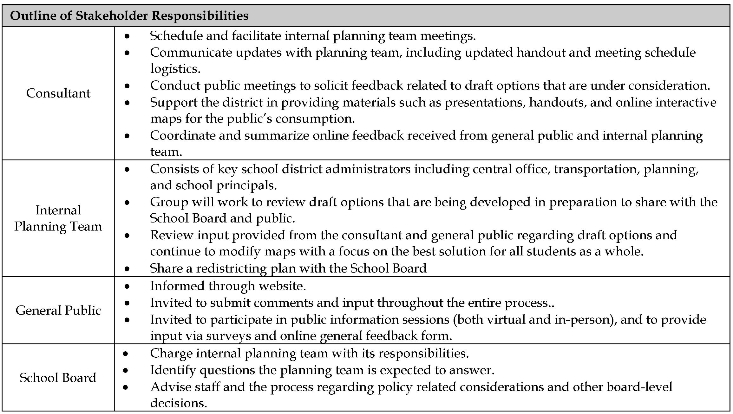
Stakeholders

Slide 7
Timeline

Slide 8
Project Objectives
Funded by the acceptance of the 2023 levy and bond issue, the Dublin City School District is undertaking a redistricting study to prepare for a new Elementary School (Bishop Elementary) that is currently scheduled to open at the start of the 2025-2026 school year.
Redistricting will focus on incorporating the new building, balancing existing student populations, and accommodating future enrollment growth.
The Dublin City Schools redistricting study is tasked with meeting the following key objectives:
To allocate an attendance zone for Bishop Elementary School scheduled to open in the Fall of 2025.
To balance utilization/relieve overcrowding among the elementary schools within the study area.
To make best efforts to ensure that Fall 2025 boundary changes align with long-term facilities and Elementary to Middle School feeder patterns.

Slide 9








Redistricting Study Criteria
Balance school facility utilization – Make every effort to have equitable utilization (where possible) across the district and in accordance with school capacities. Make efficient use of available space.
Consider economic, cultural, and ethnic diversity – Ensure schools are inclusionary and not adversely affected by redistricting decisions.
Close Proximity – Students should be assigned to the school within the closest proximity to their homes where possible.
Maximize busing efficiencies in transportation of students – Make every effort to account for transportation (school bus and car rider), parent commuting patterns, balance busing travel time, and costs.
Make every effort to establish contiguous zones – Avoid creating zones that are not connected to the primary attendance zone, where possible.
Account for future growth – Allow for increasing attendance in high growth areas.
Establish clear feeder patterns and continuity – Make every effort to establish a clear feeder pattern system.
Use major roads and natural boundaries wherever feasible to define attendance zones – Minimize the number of students who need to cross major intersections and other barriers to maximize the safety and security of students

Slide 10
IPT’s Progress
Work done to date
Data and information examined includes school enrollment (grade level, attending school and counts in neighborhoods, demographics), school capacity, zoning maps, & future development trends.
Meetings with staff and IPT members to review relevant data and draft options for consideration.
Options are considered DRAFT throughout the process; continued dialog and consideration of data is always encouraged.

Slide 11
IPT’s Progress
Work done to date
IPT’s charge is to recommend one option for the Superintendent to present to the Board of Education
Nothing will be FINAL until the Superintendent makes his final recommendation to the Board of Education

Slide 12
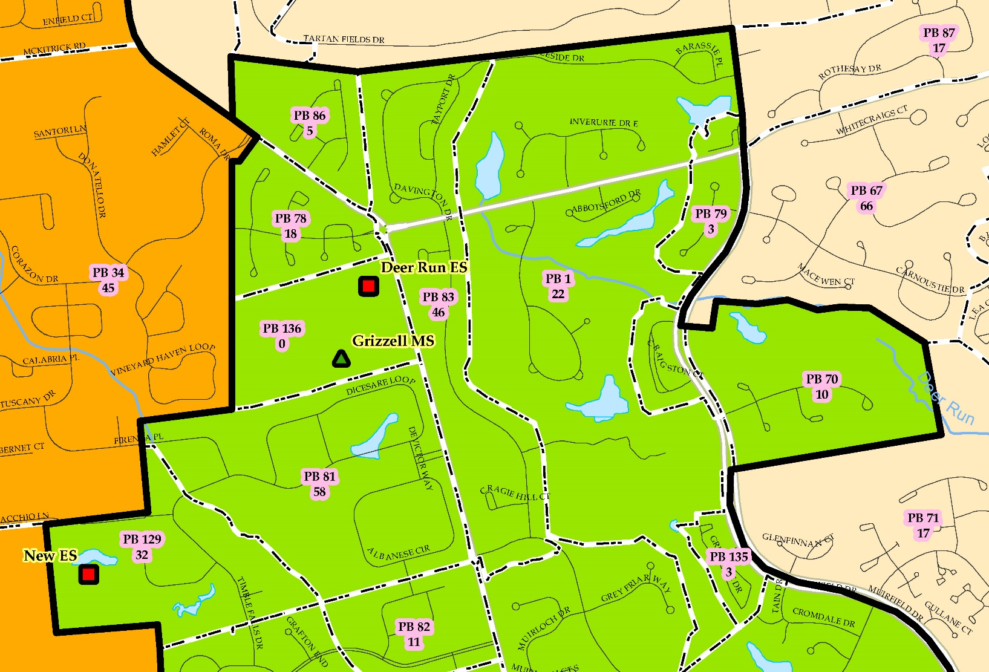
Interpreting Maps
Page 7-19 of Background Report & Appendix A
Planning Blocks: small areas for examining student populations:
  Map titles and notes clarify what each planning block map represents.
  Labels within planning blocks represent one of the following:
    Planning block ID (PB #) Map Note: Based on Fall 2023 Student Enrollment. The top labels show the Planning block ID (PB #). The bottom labels show the number of K-5 DCS students that live and attend their boundary school within the study area.

Slide 13
Interpreting Tables
Statistics that are pertinent to the study are made available to accompany the large maps.
The data shown is the data the IPT uses to evaluate options.

Slide 14
Interpreting Tables
Enrollment and Utilization – Official October 2023 Enrollment

Slide 15
Interpreting Tables
Estimated Enrollment, Over/Under Capacity, & Utilization Tables

Slide 16
Interpreting Tables
Impact Tables
DRAFT Option shown as sample. All tables included in handout.
Key: Green represents K-5th grade “Live In” students who live in the boundary and are not impacted by the option.
Pink represents the number of K-5th grade “Live In” students who live in the boundary and are impacted by the option.

Slide 17
Interpreting Tables
Feeder Pattern Tables

Slide 18
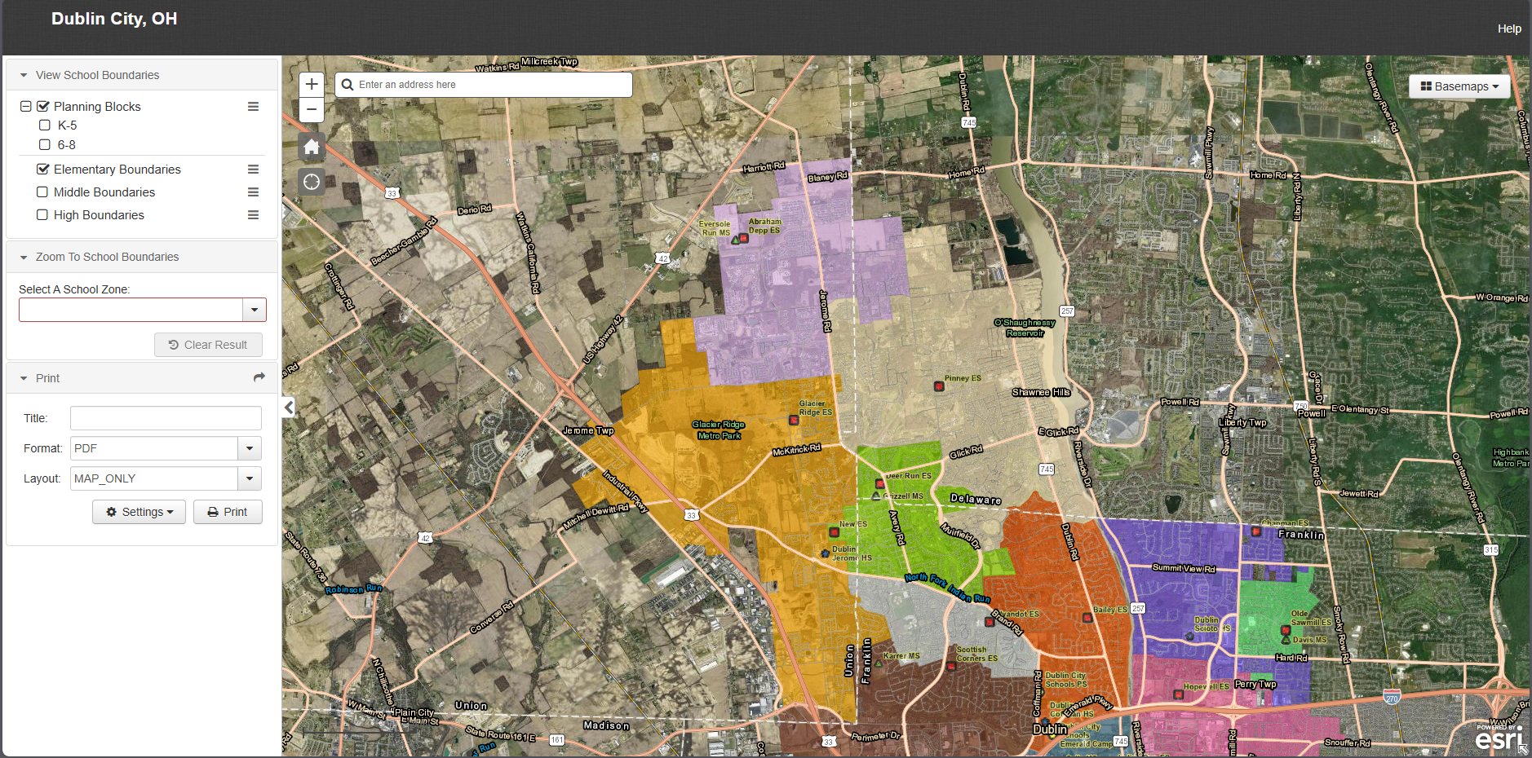
Review of DRAFT Option
8.5”x11” maps, as well as plots of maps are available for review
Option maps are also now on interactive Web https://croppermap.com/dublincity_oh/
Copies of the handouts, including small and large format maps are posted on the Redistricting Study Website: www.dcsredistricting.com

Slide 19
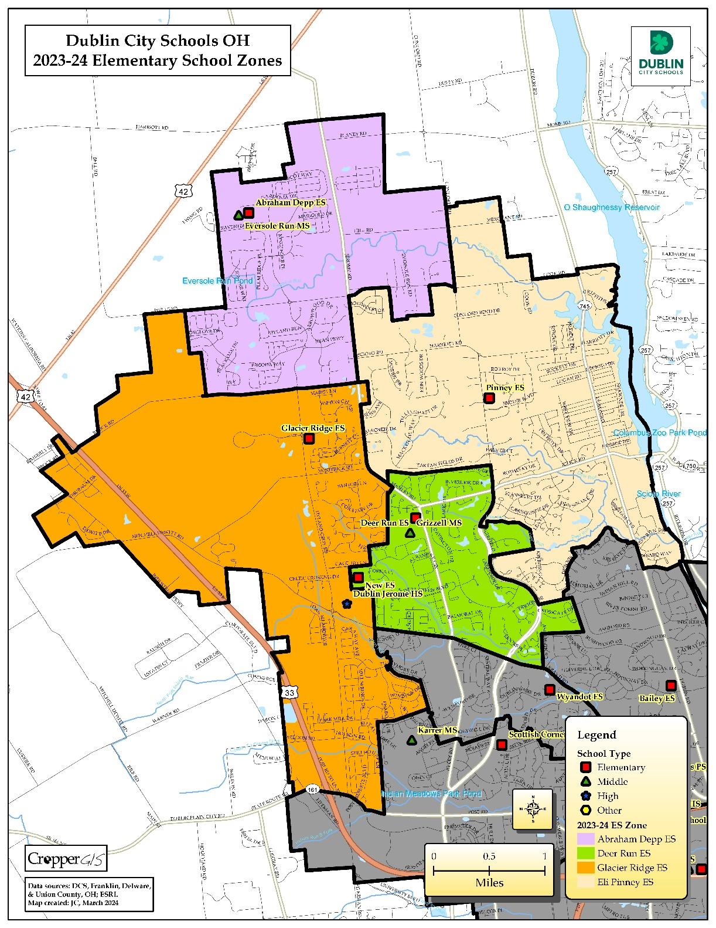
Current ES Zones

Slide 20
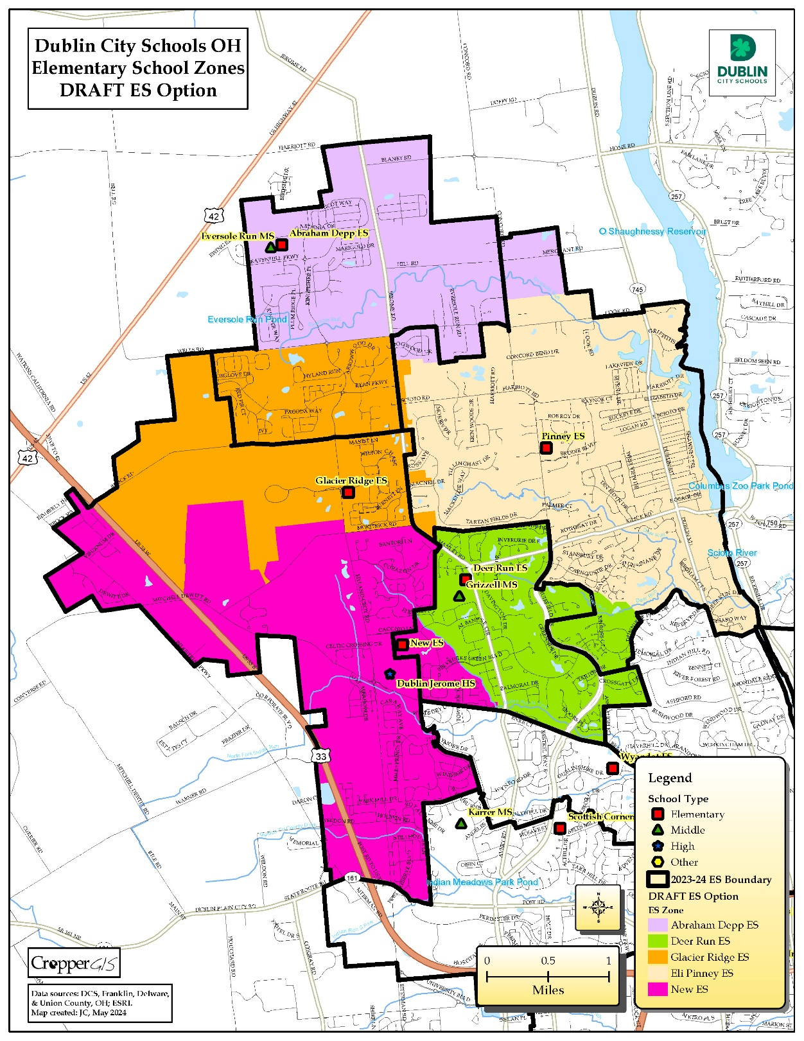
DRAFT ES Option

Slide 21
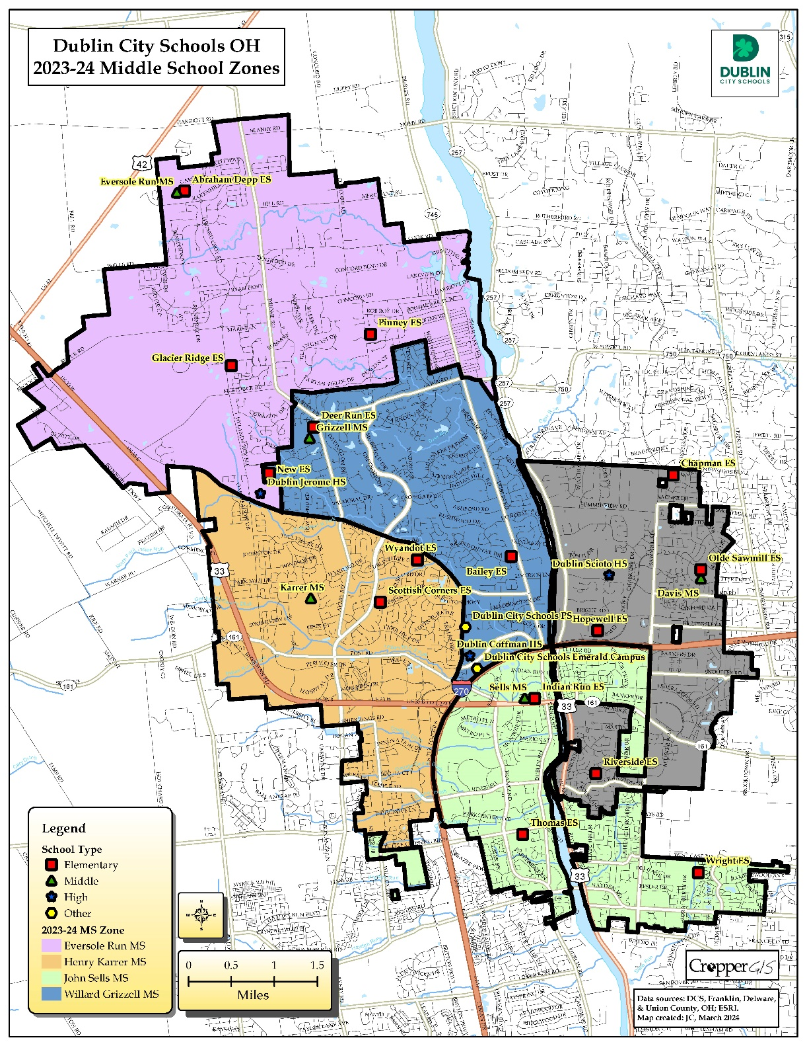
Current MS Zones

Slide 22
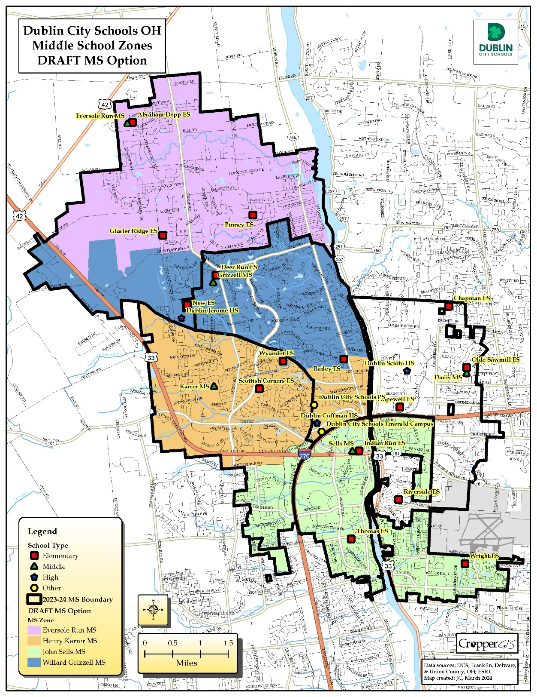
DRAFT ES Option

Slide 23
Tonight:
Detailed Review of Maps– the end of the presentation will include a gallery walk to review the DRAFT Options and related data with members of the public.
  IPT members, DCS Staff, and consultant will be available after the presentation to answer questions the public may have
  Although answering any questions the night of the meeting is very important, please submit your feedback via the comment form on the Redistricting study website and/or via the online survey for the entire IPT’s benefit

Slide 24
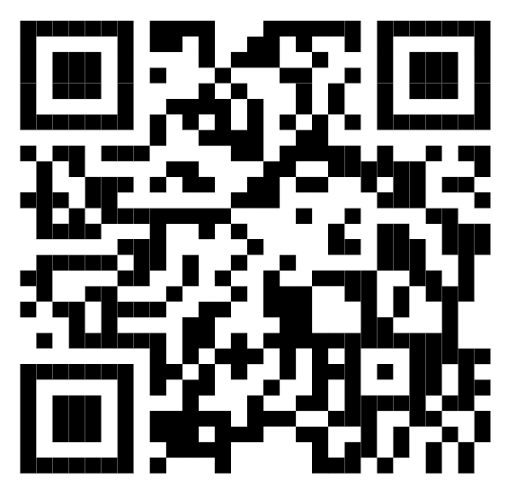
Stay Informed – Provide Feedback
  Visit the Redistricting Study Web site at dcsredistricting.com
  Participate in an Online Survey from Oct. 21 – Nov. 3, 2024
    Link is located on dcsredistricting.com or you can go directly HERE
    You can also access the survey by referencing the QR code on this slide.
    Available to translate to multiple languages.
    Survey can be taken on any PC/Apple/mobile device with Internet access
  Although the formatted survey is preferred, you can also submit comments via the online Dublin City Schools, OH - 2024 Redistricting Study General Feedback Form
  Presentation of a Recommendation to the Board of Education is scheduled on December 9, 2024.

Slide 25
Now is the time to review the maps and statistics outside of the auditorium
Thank You for your time and participation!

